Slide 1
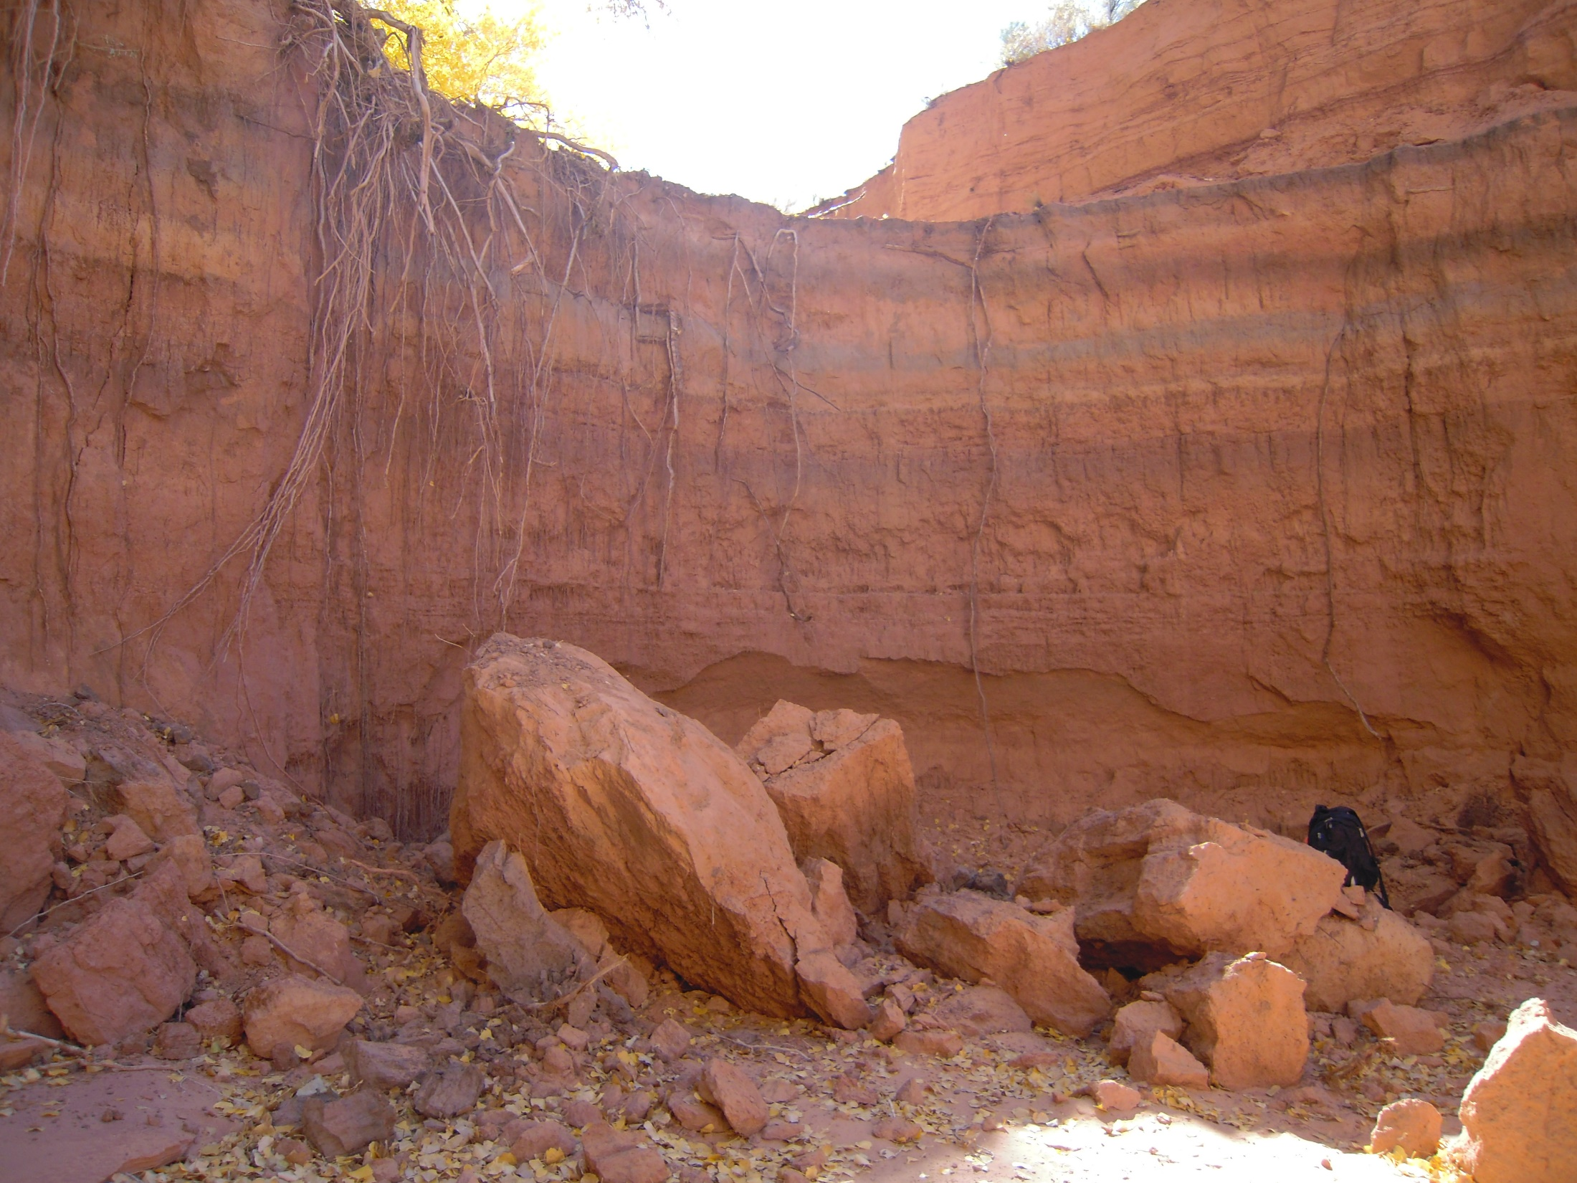
Tsegi Wash
Dan Larson, Leticia Delgado, Jessica Carnes
CENE 476

Slide 2
Presentation Outline
Project Understanding
  Introduction & Background
  Client, Technical Advisor & Stakeholders
  Project Description
Scope of Services
  Task 1 – Site Assessment
  Task 2 - Hydrology
  Task 3 - Hydraulics
  Task 4 - Armoring Design
  Task 5 – Impacts Evaluation
  Exclusions
  Schedule
  Deliverables

Slide 3
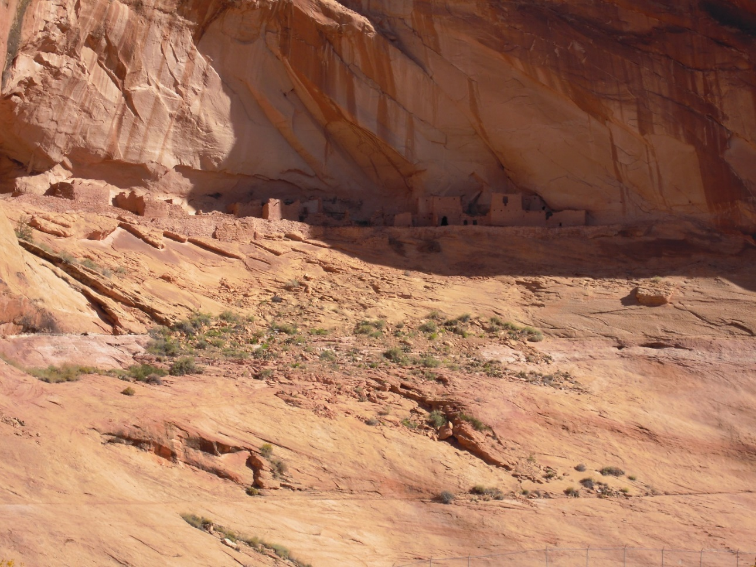
Introduction & Background
Background
  Located at Nitsin Canyon, West of the Navajo National Monument
  Inscription House closed to public since 1968
  50 years ago canyon contained farmland and housing structures
  30-40 years ago headcuts began spreading along canyon
  Canyon drains into Lake Powell
  Annual rainfall in Kayenta is 12.81 inches
  Land user, Jerry H Begay, cattle grazing causing eroding

Slide 4
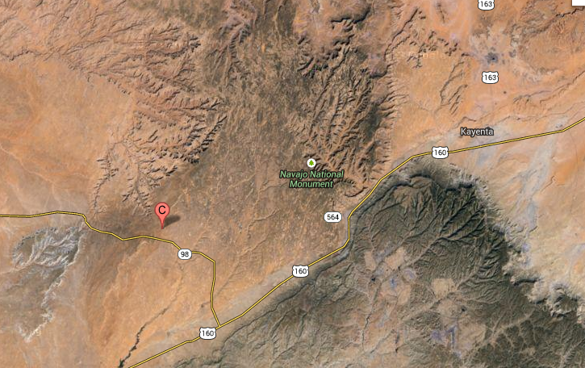
Location
Aerial View of Nitsin Canyon and Surrounding Area

Slide 5
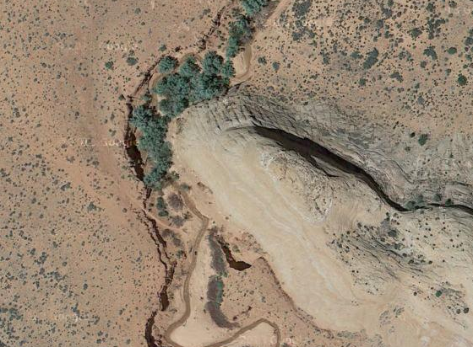
Aerial View of Site Location

Slide 6
Stakeholders
Client
Technical Advisor
Bureau of Indian Affairs
Navajo Nation
National Park Service
Land Users
Visitors
Wildlife
Renee Benally
Natural Resource Specialist
Acting Navajo Region Noxious Weed Coordinator
Navajo Region Youth Liaison https://youthgo.gov/
Western Navajo Agency, Branch of Natural Resources
Mark Lamer
CENE 476 Professor

Slide 7
Project Description
Existing Conditions
  23 ft. headcut
  Lack of soil stability due to cattle grazing and lowering of the water table
  Native vegetation includes:
    Cottonwood trees
    Weeds
    Shrubbery
  Bed material consists of sandy soil
  Cottonwood roots only source of current stabilization
  Headcut ¼ mile downstream from point water source

Slide 8
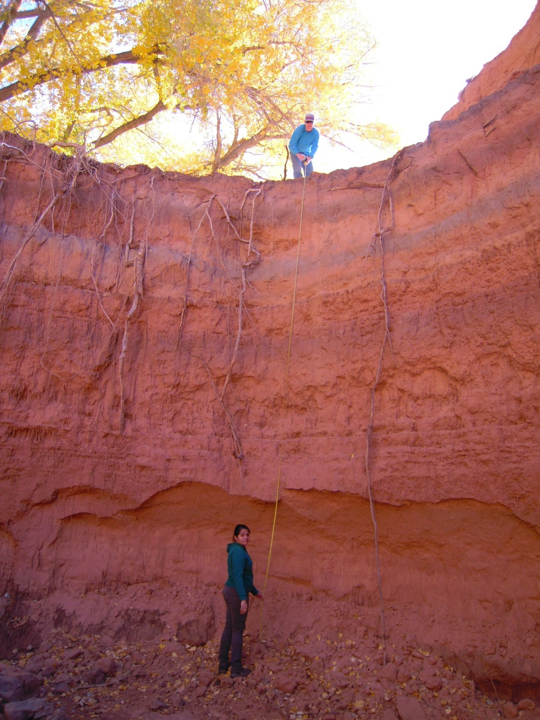

Slide 9
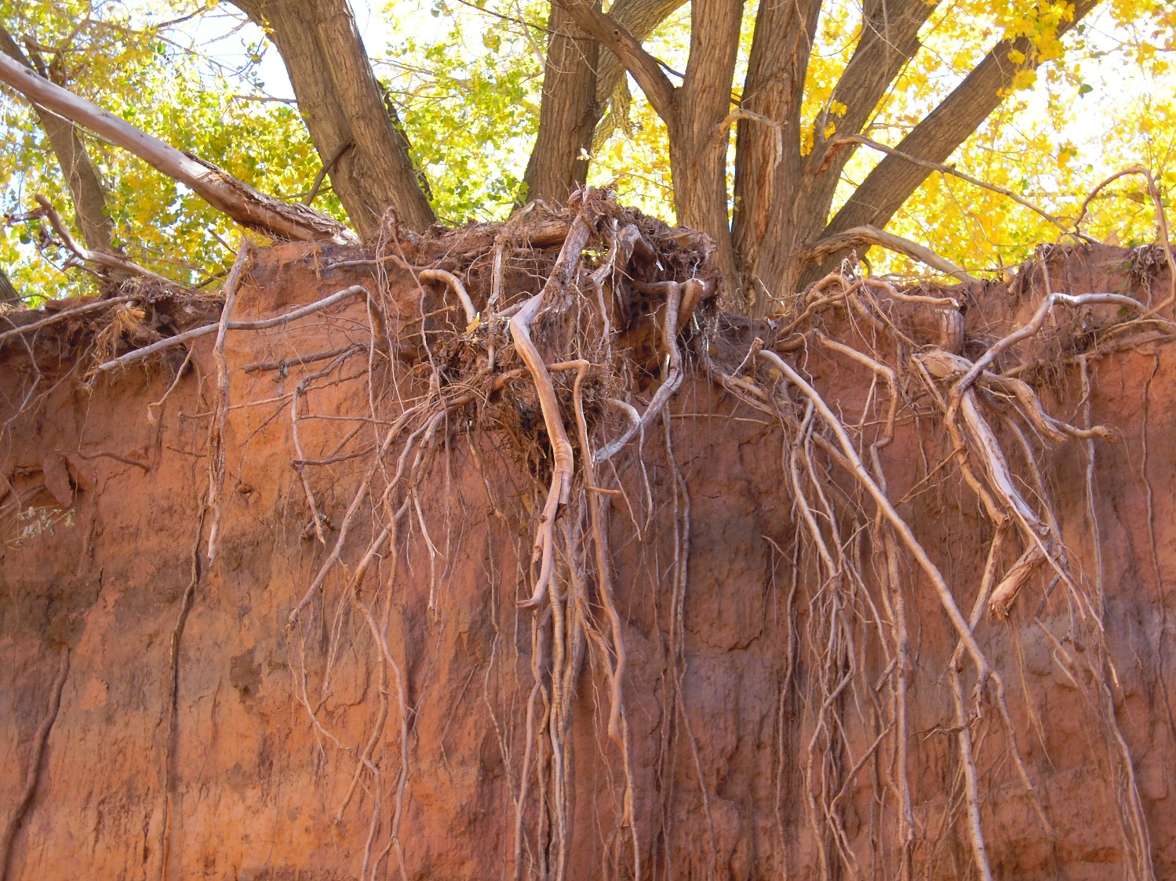
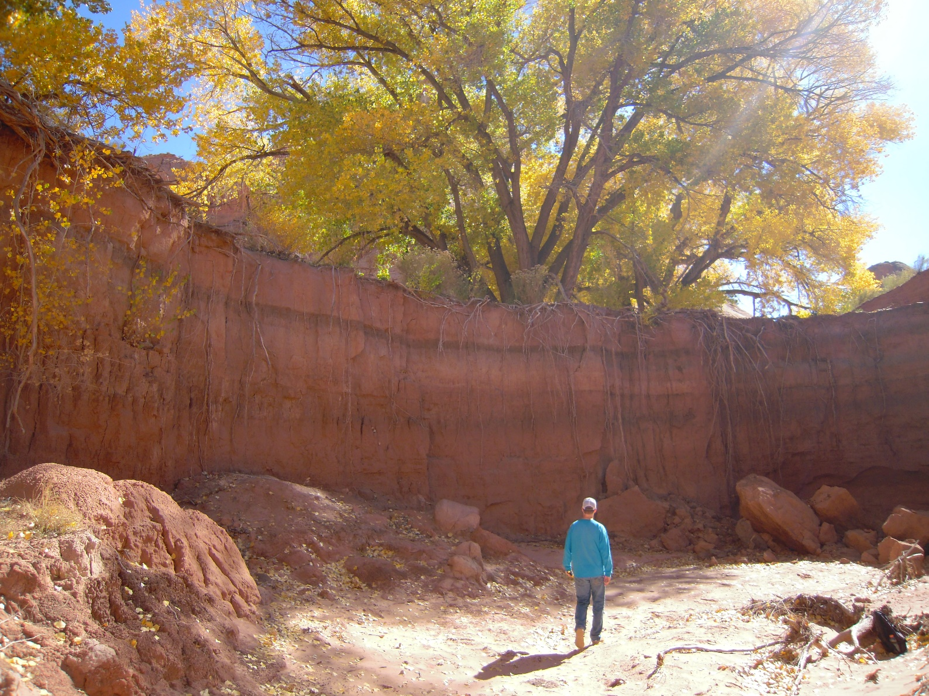

Slide 10
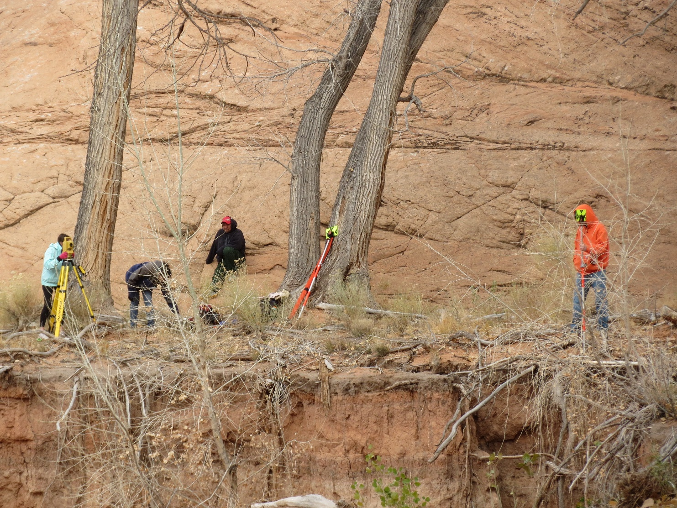
Task 1 – Site Assessment
Site Visit
Land Use Survey
Roughness Coefficient

Slide 11
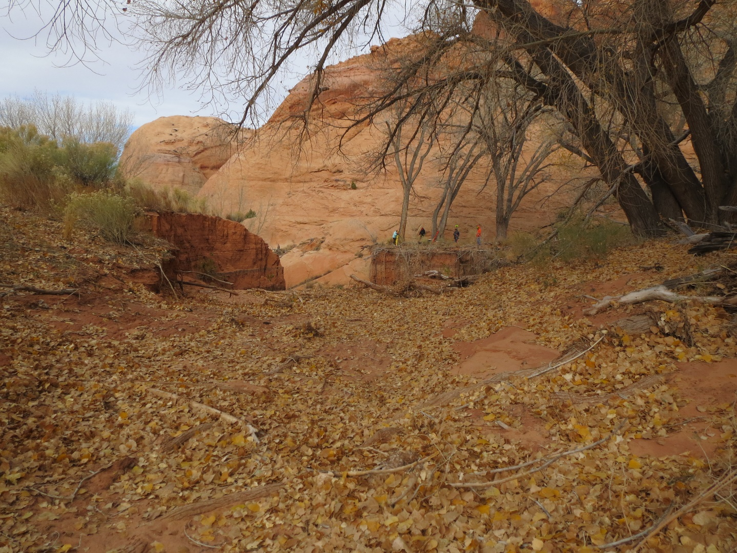
Task 2 - Hydrology
Delineate Watershed
Hydraulic Radius
Gage Data/Research
Determine Flow
Determine Velocity

Slide 12
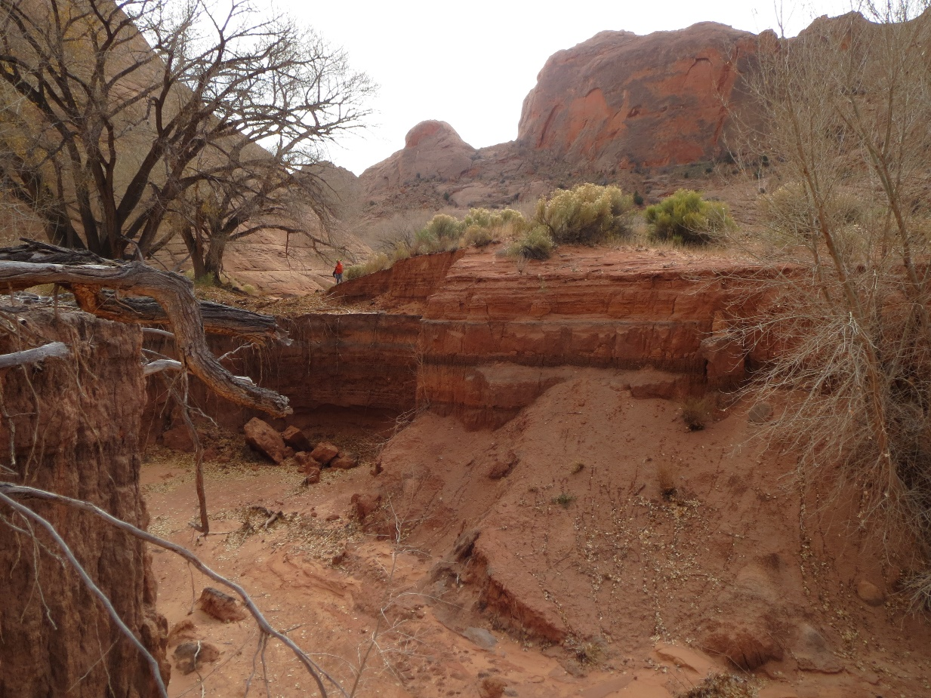
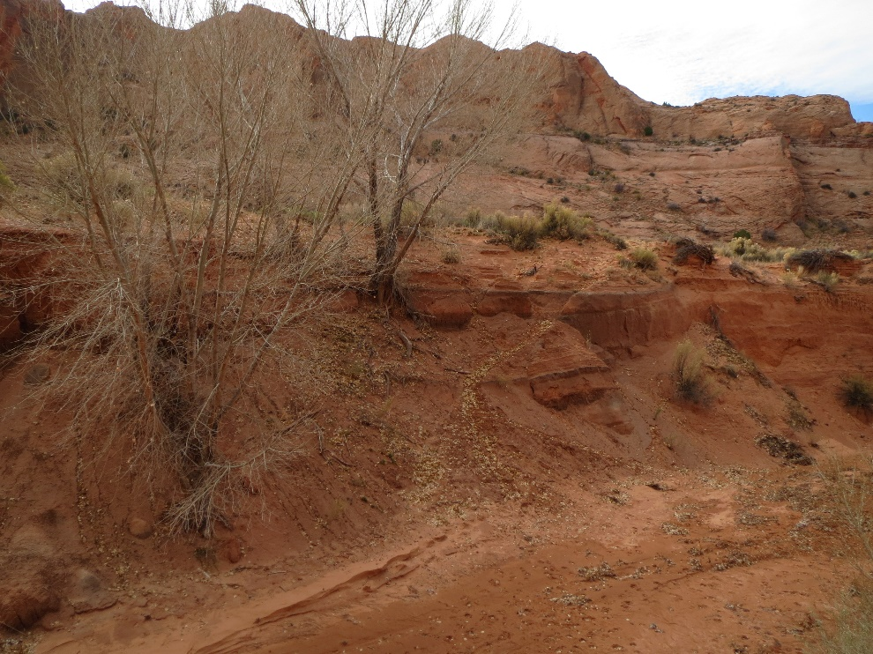
Task 3 – Hydraulics
Modeling Software
  Determine Flow Characteristics

Slide 13
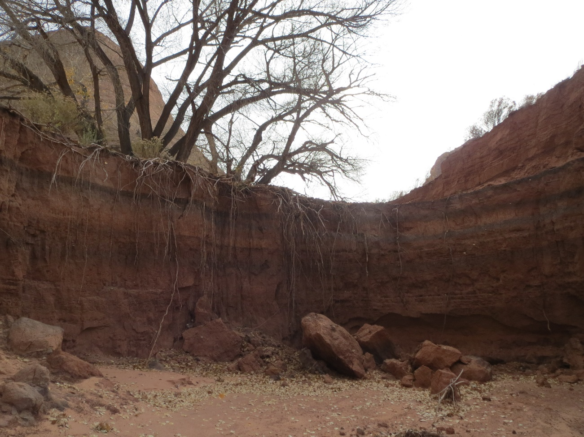
Task 4 – Armoring Design
Design Best Stabilization
  Live Planting: Use of native vegetation
  Bioengineering: Use of structural materials combined with native vegetation
  Hard-Armor: Use of various sized rocks i.e. riprap and gabions
Constraints
  Difficult location
  Large scale headcut
  Limited budget
  Limited available material

Slide 14
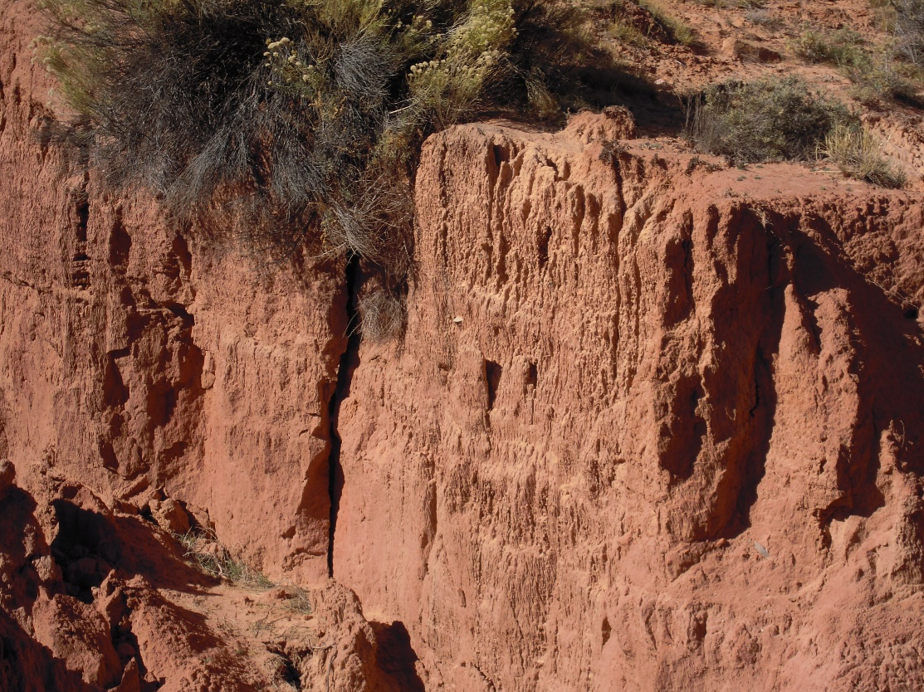
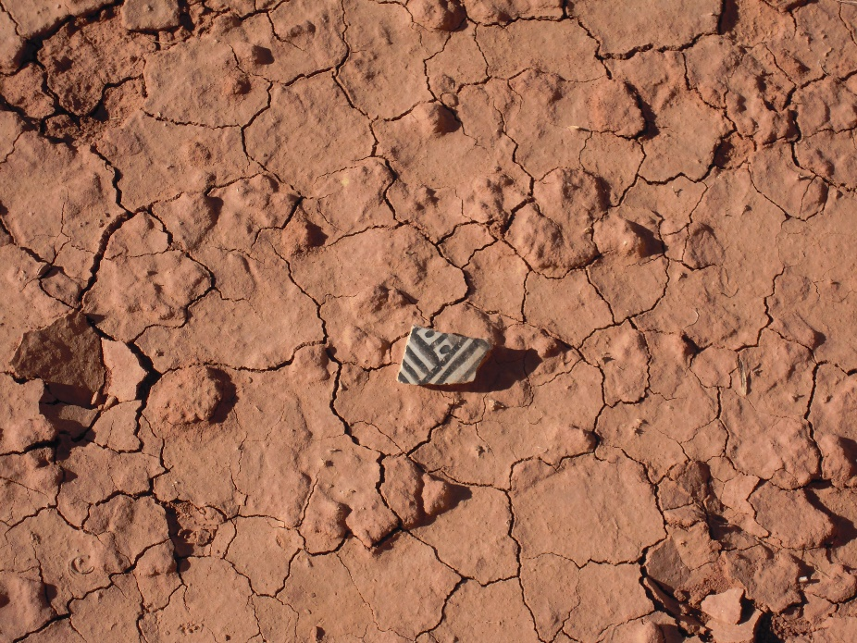
Task 5 – Impacts Evaluation
Economic Impacts – Evaluation of the design cost and feasibility for the client
Cultural Impacts – Evaluation of design to assure no cultural artifacts and/or spiritual beliefs of the Navajo nation are at risk
Ecological Impacts – Evaluation of the effect of design to vegetation and wildlife nearby to the site

Slide 15
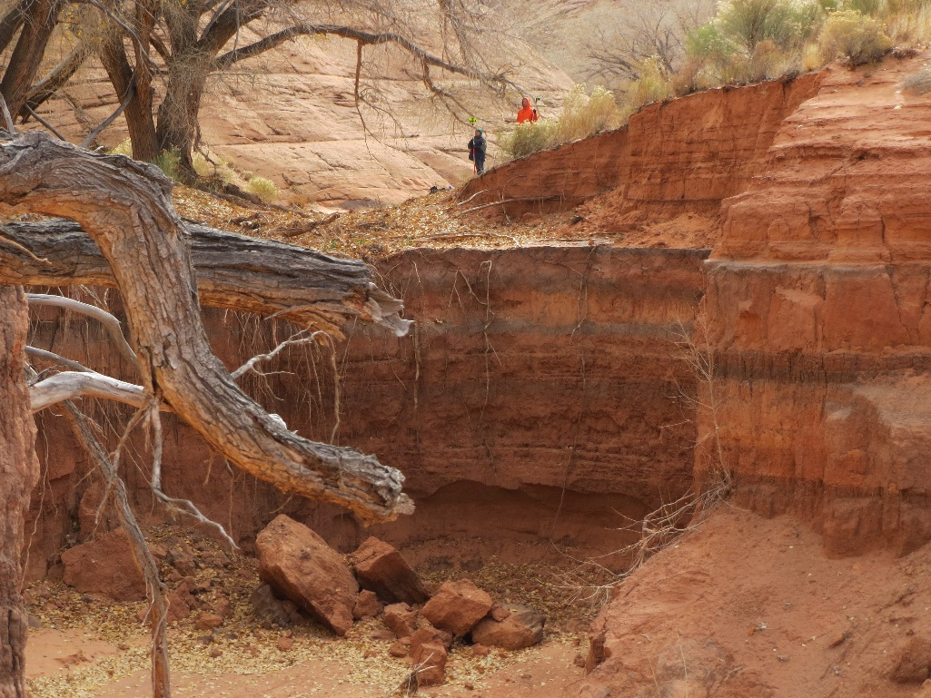
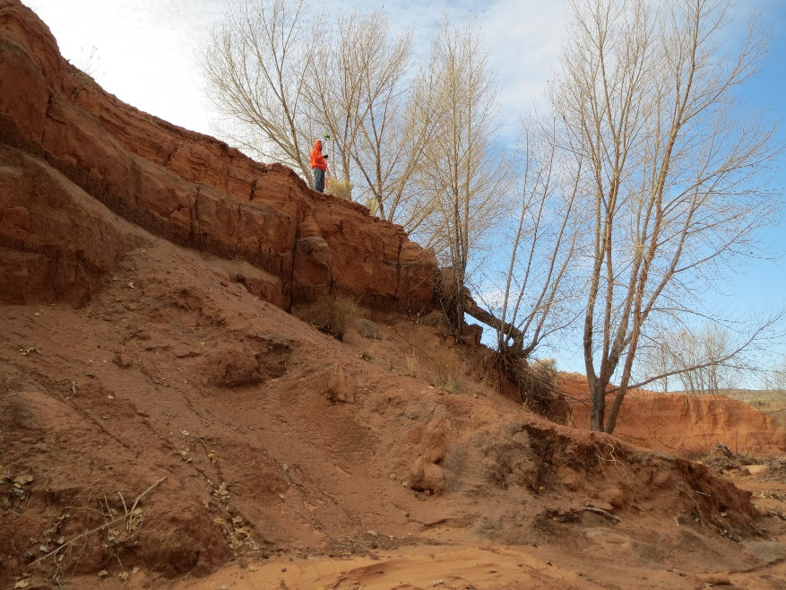
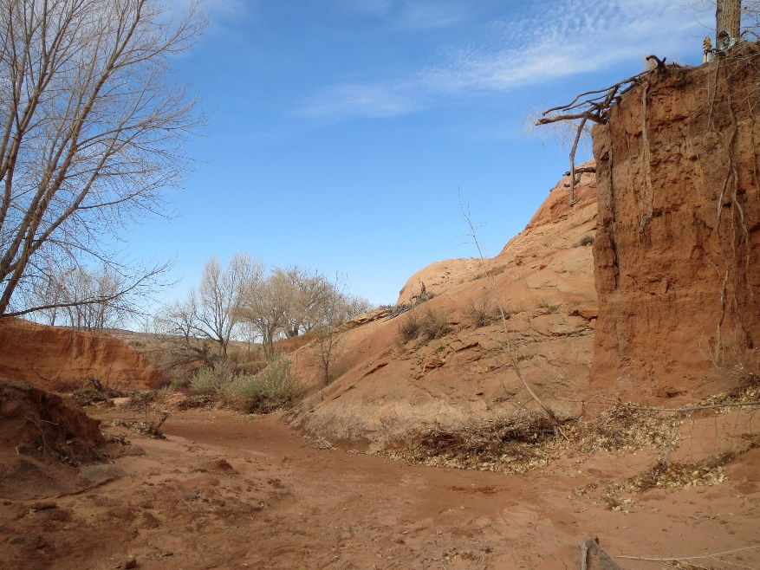
Exclusions
Soil Analysis
Extensive Surveying
Geotechnical Analysis
Vegetation Analysis
Construction Plans

Slide 16
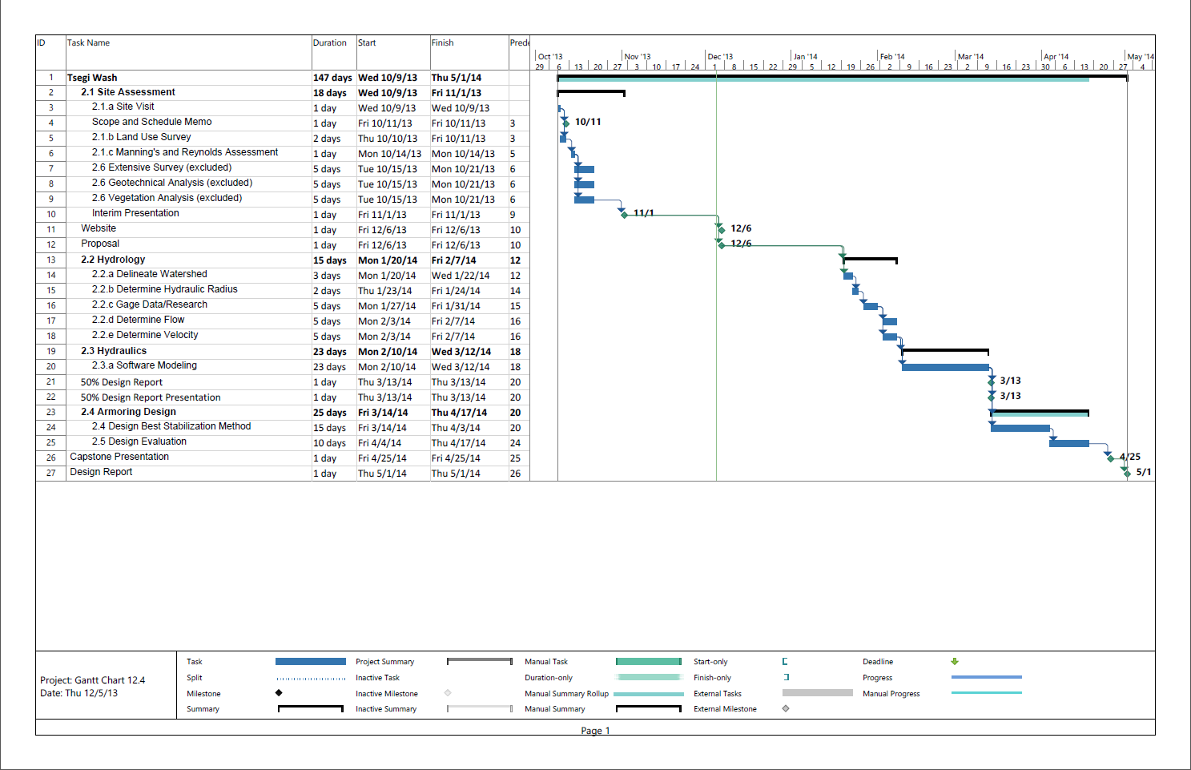

Slide 17
Project Cost – Cost of Services
Task | Senior Engineer (hrs) | Engineer (hrs) | EIT (hrs) | Tech (hrs) | Admin. Asst. (hrs) | Total Hours | Total Cost of Task ($)
Fieldwork |  |  | 14 | 10 |  | 24 | 1399.2
Hydrology |  | 30 | 40 | 30 |  | 100 | 7735.2
Hydraulics |  | 20 | 20 |  |  | 40 | 4048
Armoring Design | 35 | 25 | 10 | 10 |  | 80 | 9417.65
Impacts Evaluation | 20 | 4 |  |  |  | 24 | 3495.8
Document | 20 |  | 30 | 20 | 70 | 140 | 9617.3
Total | 75 | 79 | 114 | 70 | 70 | 408 | 35,713

Slide 18
Project Cost – Overall Cost
1.0 Personnel | Person | Hours | Rate, $/hr | Cost, $
 | Senior Eng. | 75 | 150.15 | 11,261
 | Engineer | 79 | 123.2 | 9,733
 | EIT | 114 | 79.2 | 9,029
 | Tech | 70 | 29.04 | 2,033
 | Admin. Asst. | 70 | 52.25 | 3,658
 | Total Personnel |  |  | 35,713
2.0 Travel
 | 2 visits * 254mi/visit | $0.40/mi |  | $203
3.0 Subcontractor
 | Surveying |  |  | $7,500
 | Geotech Analysis |  |  | $5,000
 | Vegetation Analysis |  |  | $2,500
 | Total |  |  | $15,000
4.0 Reimbursable |  |  | $/mo
 | Rent |  | $1,500
 | Utilities |  | $500
 | Supplies |  | $750
 | Vehicle |  | $1,000
 | Admin |  | $1,500
 | Total Reimbursement |  |  | $5,250
 |  |  | w/ 50% profit | $7,875
5.0 Total |  |  | Without Reimbursement | $50,916
 |  |  | With Reimbursement | $58,791

Slide 19
Deliverables
Website – December 6, 2013
Final Proposal – December 6, 2013
Final Presentation – December 17, 2013
50% Design Report – March 13, 2014
50% Design Report Presentation – March 13, 2013
Final Presentation – April 25, 2013
Final Design Report – May 1, 2013

Slide 20
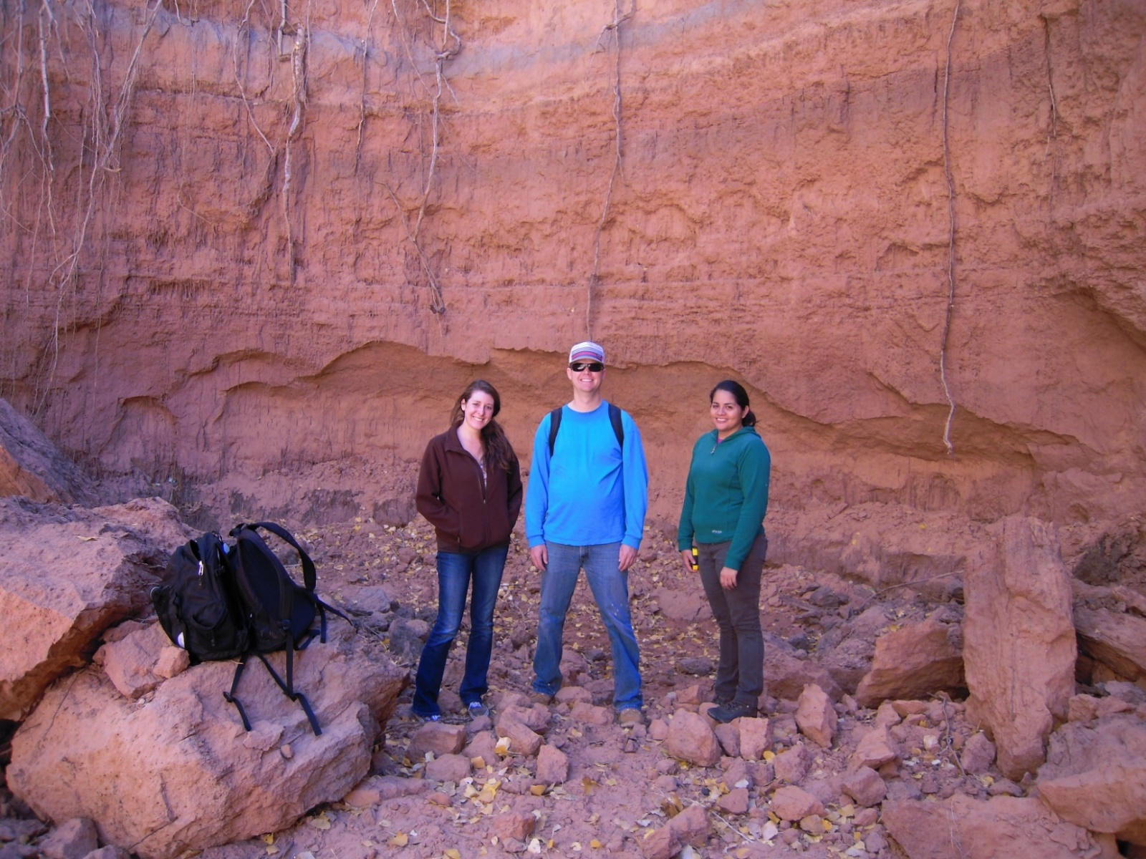
Questions

